Slide 2
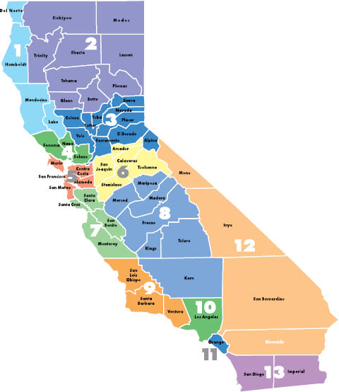
Rural Northern Area Simulation Collaborative (RNASC)
California Simulation Alliance Regional Collaboratives
Capital Area Simulation Collaborative (CASC)
Bay Area Simulation Collaborative (BASC)
Central Valley Simulation Collaborative (CVSC)
Southern California Simulation Collaborative (SCSC)
Inland Empire Simulation Collaborative (IESC)
San Diego Simulation Collaborative (SDSC)
March, 2017
Notes:
2
2
----- Meeting Notes (8/16/12 14:14) -----
Regional spelled wrong.
USF

